Slide 1
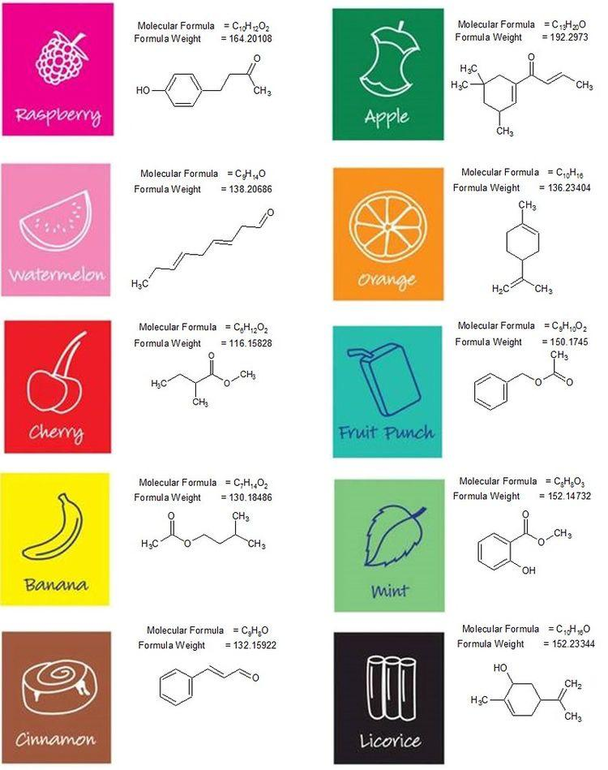
Chapter 8
Functional groups

Slide 2
Review :
A- law of definite proportions:
Let CxHyOz be the general formula of an organic compound
According to the law of definite proportions
We can write the following expression:

Slide 3
Application 1:
An organic compound contains the elements C, H and O of mass 0.814 g. quantitative analysis gives 1.936 g of a gas which cloudy lime water and 0.99 g which makes anhydrous copper sulfate blue.
1-Determine the percentage composition by mass of each constituent element of this compound.
2-Deduce its molecular formula knowing that its molar mass is M = 74 g.mol⁻¹.

Slide 4
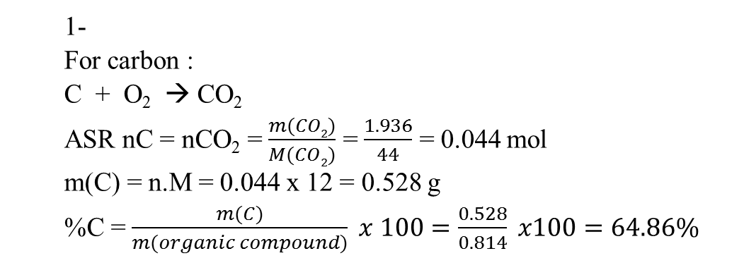

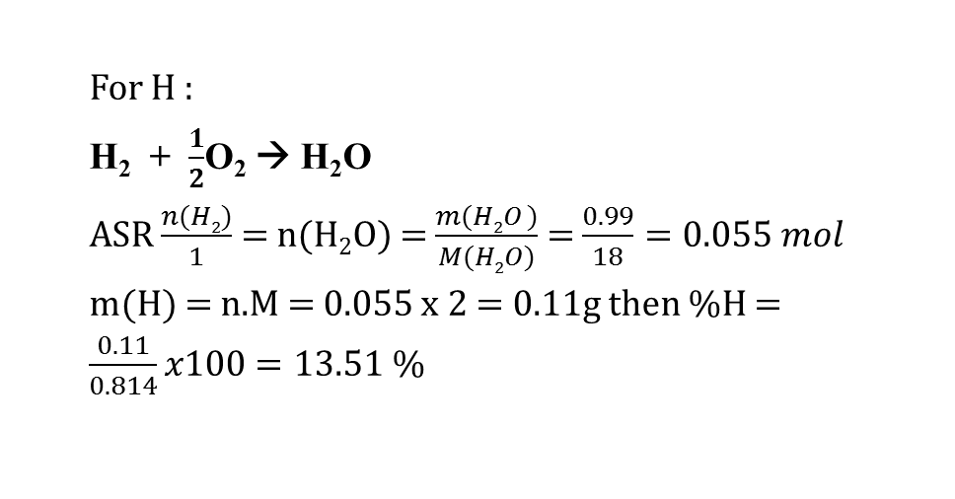
1-
For carbon :
C + O₂ → CO₂
ASR nC = nCO₂ = $\frac{m(CO2)}{M(CO2)}$ = $\frac{1.936}{44}$ = 0.044 mol
m(C) = n.M = 0.044 x 12 = 0.528 g
%C = $\frac{m(C)}{m(organic compound)} x 100=\frac{0.528}{0.814} x100=64.86\%$
For H :
H₂ + $\frac{1}{2}$O₂ → H₂O
ASR $\frac{n(H2)}{1}$= n(H₂O) = $\frac{m(H2O )}{M(H2O)}$ = $\frac{0.99}{18}=0.055 mol$
m(H) = n.M = 0.055 x 2 = 0.11g then %H = $\frac{0.11}{0.814}x100=13.51 \%$
% O = 100 – (64.86 + 13.51) = 21.6 %
2- to determine the molecular formula we apply the law of definite proportions
$$\frac{M(A)}{100}=\frac{12x}{\%C}=\frac{y}{\%H}=\frac{16z}{\%O}$$
by replacing each term by its value we obtain the molecular formula
C₄H₁₀O

Slide 5
Empirical formula
The empirical formula of an organic compound gives the
relative number of each type of atom in it. It represents the
relative smallest number of atoms in the organic compound.
To determine the empirical formula:
→ Convert the % by mass of each element to grams
(suppose 100 g of Compound)
→ Convert grams to moles
→ Divide each mol by the smallest number to get the E.F.

Slide 6

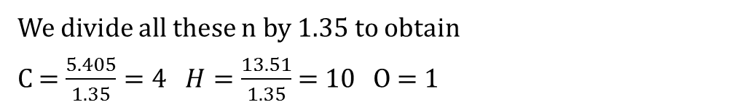
From the application 1:
We have
%C = 64.86 then mass of C = 64.86g
%H = 13.51 then mass of H = 13.51g
%O = 21.61 then mass of O = 21.61g
$nC=\frac{m}{M}=\frac{64.86}{12}=5.405$ mol
nH = $\frac{13.51}{1}$ = 13.51 mol
nO = $\frac{21.61}{16}$ = 1.35 mol
We divide all these n by 1.35 to obtain
C = $\frac{5.405}{1.35}=4 H=\frac{13.51}{1.35}$ = 10 O = 1
Then the empirical formula will be (C₄H₁₀O)n
Application page 203
Exercises 3-5

Slide 7
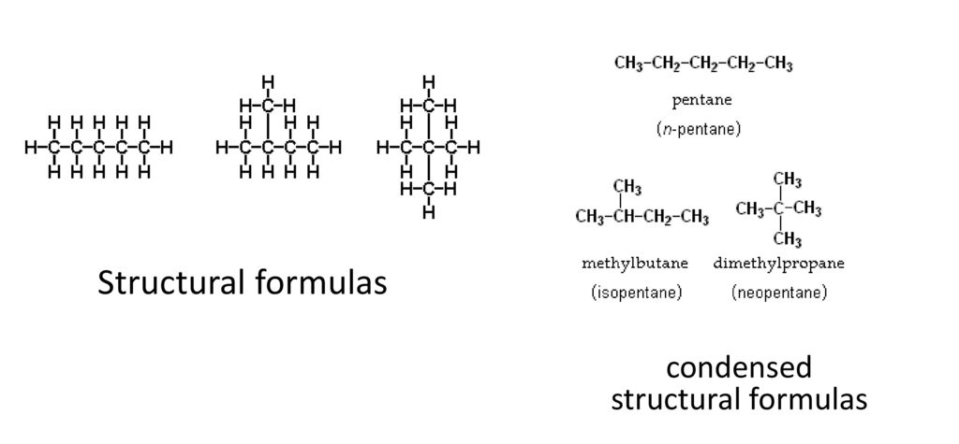
B- molecular formula – structural formula- condensed structural formula:
Molecular formula : C₅H₁₂

Slide 8
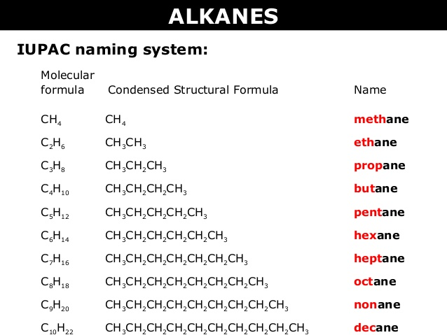
C- Alkanes:
- Alkanes are saturated hydrocarbons
- General formula : C_{n}H_{2n+2}
All bonds between carbon atoms are single covalent bond
Name ends by “ane”

Slide 9
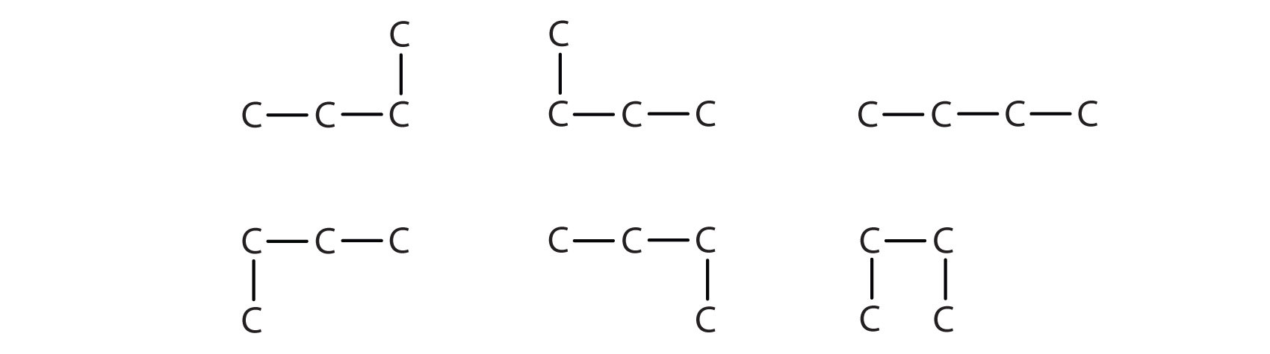
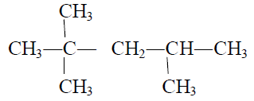
Straight and branched chain of alkanes:
- Straight chain : carbon atom is bonded to 2 carbon atoms
- Branched chain: carbon atoms are bonded to more than 2 carbon atoms

Slide 10
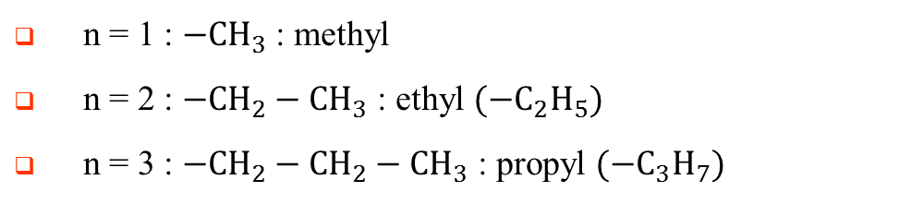
Nomenclature of a branched chain:
if the chain is branched ,there are branches called alkyl groups of general formula C_{n}H_{2n+1}
n = 1 : $−{CH}_{3}$ : methyl
n = 2 : $−{CH}_{2}−{CH}_{3}$ : ethyl $({−C}_{2}H_{5})$
n = 3 : $−{CH}_{2}−{CH}_{2}−{CH}_{3}$ : propyl $({−C}_{3}H_{7})$
Rules to name the chain according to IUPAC?
Choose the main chain which is the longest chain
Number the main chain from the nearest to the branch (smallest numbering)\
If the main chain contain same branches
2 same branches we add “di”
3 same branches we add “tri”
If the branches are different we name them by their alphabetical order

Slide 11
CH₃
CH₃
CH₃
CH₂
CH
CH₃
CH₃
CH₃
CH
CH
CH₃
CH₃
CH
CH
CH₂
CH₃
CH₃
CH₃
CH₃
CH
CH
CH₂
CH₂
CH₂
CH₃
CH₃
CH₂
CH
CH
CH₃
C₂H₅
CH₃
CH₃
C₂H₅
CH₃
CH₃
C
CH₂
CH₃
CH₃

Slide 12
Isomers:
Definition:
These are compounds with the same molecular formula but different structural formulas.
Write all possible condensed structural formulas of butane C₄H₁₀
And give their names
CH₃
CH₂
CH₂
CH₃
CH₃
CH
CH₃
CH₃
Butane 2-methyl propane

Slide 13
Isomers of C₅H₁₂ :
CH₃− CH₂− CH₂− CH₂− CH₃ pentane
CH₃− CH₂− CH− CH₃ : 2-methylbutane
│
CH₃
CH₃
│
CH₃− C− CH₃ : 2,2-dimethylpropane
│
CH₃

Slide 14
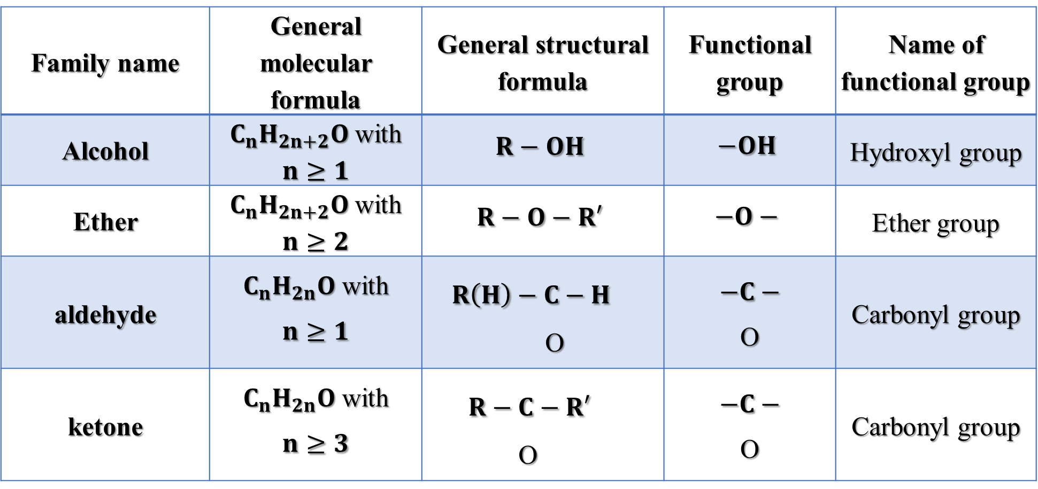
D- functional groups:
Family name | General molecular formula | General structural formula | Functional group | Name of functional group
Alcohol | $C_{n}H_{2n+2}O$ with $n≥1$ | $$R−OH$$ | $$−OH$$ | Hydroxyl group
Ether | $C_{n}H_{2n+2}O$ with $n≥2$ | $$R−O−R′$$ | $$−O−$$ | Ether group
aldehyde | $C_{n}H_{2n}O$ with $$n≥1$$ | $$R\left(H\right)−C−H$$ O | $$−C−$$ O | Carbonyl group
ketone | $C_{n}H_{2n}O$ with $$n≥3$$ | $$R−C−R′$$ O | $$−C−$$ O | Carbonyl group

Slide 15
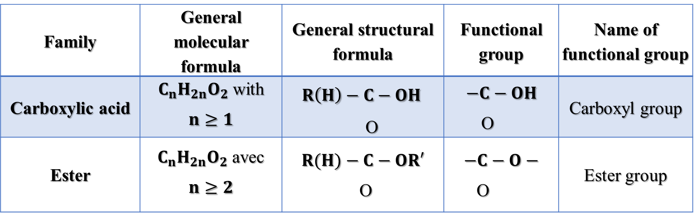
Family | General molecular formula | General structural formula | Functional group | Name of functional group
Carboxylic acid | $C_{n}H_{2n}O_{2}$ with $$n≥1$$ | $$R\left(H\right)−C−OH$$ O | $$−C−OH$$ O | Carboxyl group
Ester | $C_{n}H_{2n}O_{2}$ avec $$n≥2$$ | $$R(H)−C−OR′$$ $\text{O}$ | $$−C−O−$$ $\text{O}$ | Ester group

Slide 16
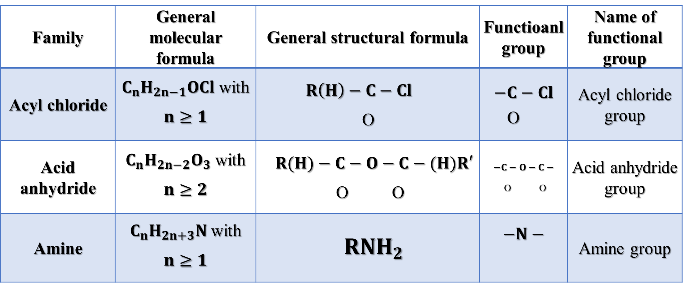
Family | General molecular formula | General structural formula | Functioanl group | Name of functional group
Acyl chloride | $C_{n}H_{2n−1}OCl$ with $$n≥1$$ | $$R\left(H\right)−C−Cl$$ O | $$−C−Cl$$ O | Acyl chloride group
Acid anhydride | $C_{n}H_{2n−2}O_{3}$ with $$n≥2$$ | $$R(H)−C−O−C−(H)R′$$ O O | $$−C−O−C−$$ O O | Acid anhydride group
Amine | $C_{n}H_{2n+3}N$ with $$n≥1$$ | $$R{NH}_{2}$$ | $$−N−$$ | Amine group

